Slide 1
Offline DevOps Case Study for Full Stack Application
(React/Angular + Spring Boot + Oracle)

Slide 2
1. Tech Stack Overview
Layer | Tech | Purpose
Frontend | React, Angular | UI
Backend | Spring Boot | Business logic
Database | Oracle | Persistent storage
SCM | Git + Gitea | Version control (offline)
CI/CD | Jenkins | Offline automation
Build | Maven | Java builds
Code Quality | SonarQube | Static analysis
Artifact Repo | Nexus | Store .jar/.war, Docker images
Container | Docker | Package apps
Orchestration | Kubernetes (K3s/Minikube) | Manage services
Monitoring | Prometheus + Grafana | Metrics & alerts
Logging | ELK Stack (optional) | Log analysis
Agile | Excel/Wekan | Scrum board offline

Slide 3
Planning : Agile Methodology (Scrum)
Scrum Activity | Tool | Notes
Product Backlog | Excel / Wekan | List of all features and requirements
Sprint Planning | Excel / Wekan | Decide scope of work for next sprint
Daily Stand-ups | Manual / Notes | 15-min status updates among team
Sprint Review | Offline Meeting | Demonstration of work completed
Retrospective | Excel / Manual | Feedback and improvement suggestions
Wekan: Self-hosted Trello-like Kanban board (can run in LAN)
Install using Docker or manually via Node.js.
Excel: Alternative for teams preferring simple tracking

Slide 4
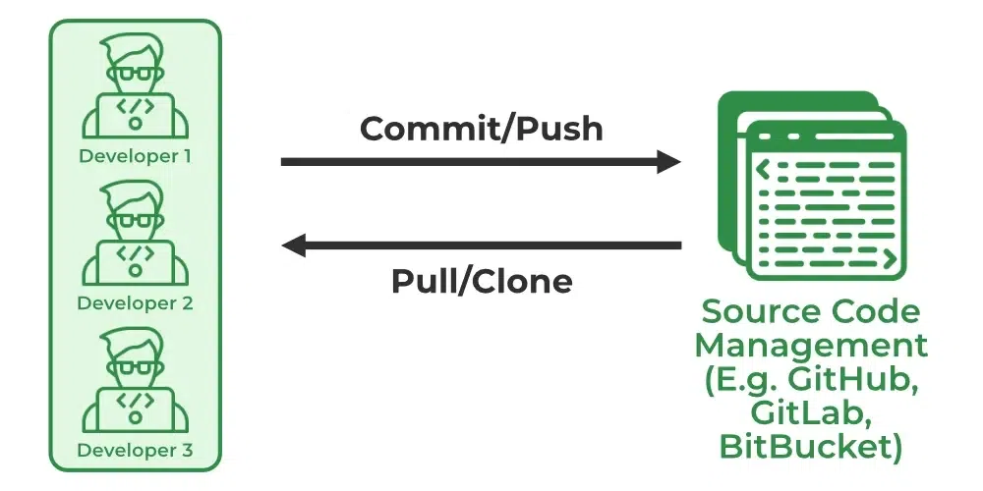
Continuous Development – Git + Gitea
Component | Tool | Description
VCS | Git | Installed on every developer machine
Git Server | Gitea | Lightweight, self-hosted Git platform
Developers clone/push/pull code via LAN using Gitea.
Enables Pull Requests, Code Review, Branching.

Slide 5
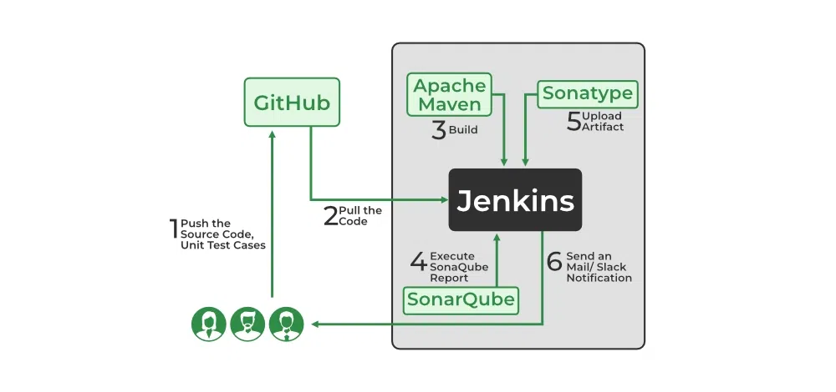
Continuous Integration – Jenkins + Maven
Continuous Integration can be explained mainly in 4 stages in DevOps. They are as follows:
Getting the SourceCode from SCM
Building the code
Code quality review
Storing the build artifacts
Jenkins pulls code from Gitea on every commit.
Compiles with Maven, runs JUnit tests.
CI/CD Flow : Code → Gitea → Jenkins → Maven build → SonarQube scan → Docker image → Nexus → Deploy to K8s → Monitor via Prometheus + Grafana → Logs collected in ELK
Component | Tool | Description
CI Server | Jenkins | Automates build pipeline
Build Tool | Maven / Gradle | Java-based project builds

Slide 6
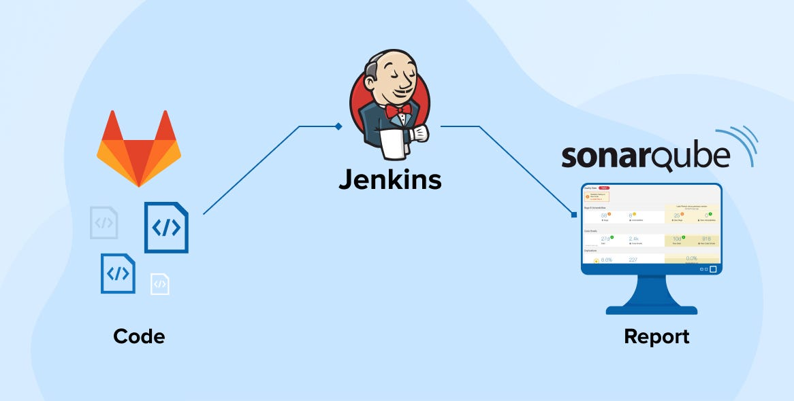
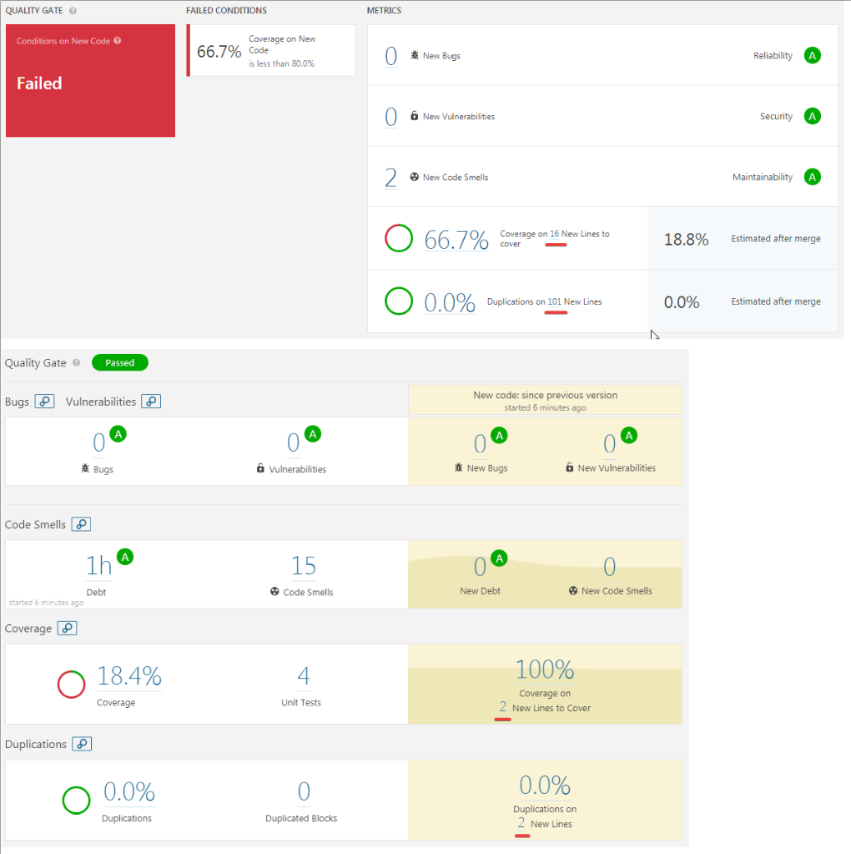
Code Quality & Security – SonarQube
Integrated into Jenkins.
Generates code smell, bug, and vulnerability reports.
Accessible via browser in LAN.
Best Practice: Define Quality Gates to block deployment if issues exceed thresholds

Slide 7
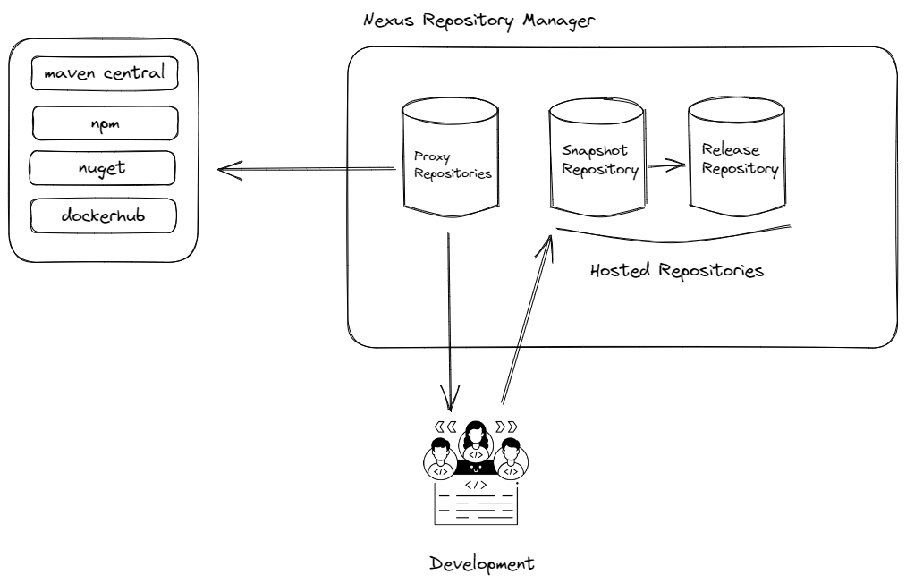
Artifact Repository – Nexus Repository Manager
Nexus is like a storage center for software files (called "artifacts"). It is commonly used in DevOps.
Java libraries (via Maven)
Docker images (for containers)
npm packages (for JavaScript)
Instead of downloading all these from the internet every time, Nexus can store them locally.

Slide 8
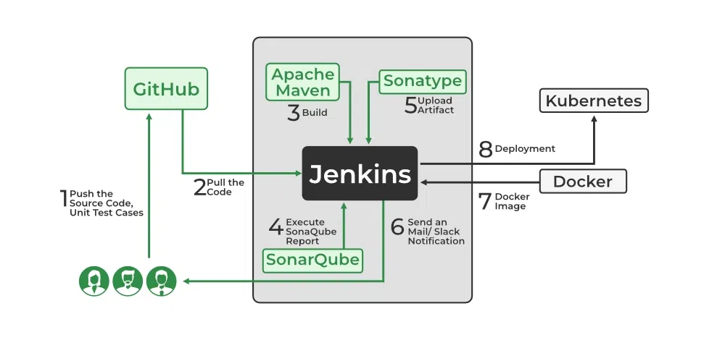
Deployment – Jenkins + Tomcat/Docker
Tomcat | Deploy WARs for testing
Docker | (Optional) For containerized apps

Slide 9
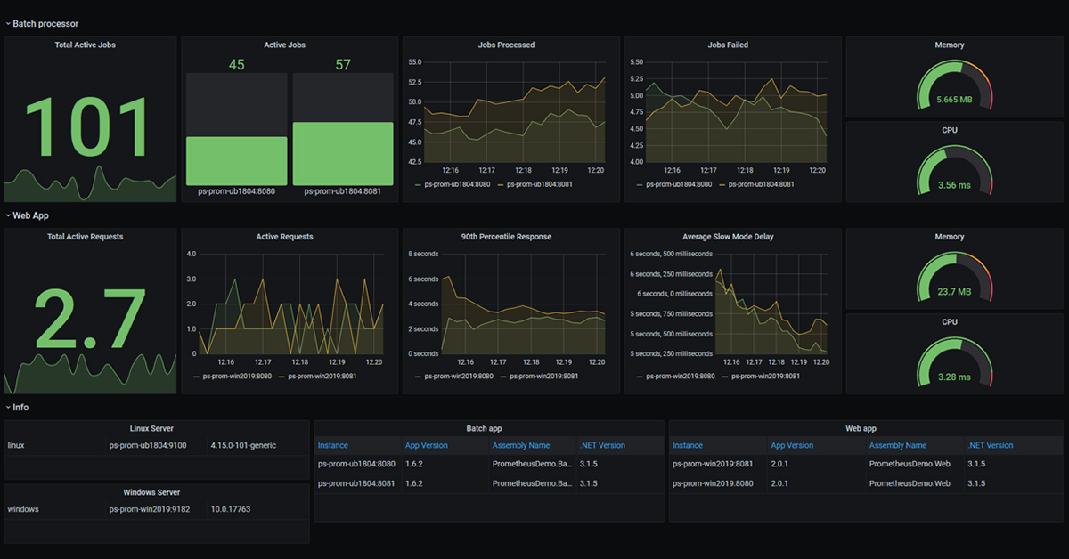
Monitoring & Logging – Basic Setup
Continuous Monitoring can be achieved with the help of Prometheus and Grafana
we can gather many performance measures
CPU and memory utilization,
network traffic,
application response times,
error rates and others (Ex : System , Docker , App metrics )
Logging means recording detailed information about what your application is doing,
when it's doing it, and if anything goes wrong, to help debug issues, track user behavior,
and monitor app health.

Slide 10
Item | Status
Git installed on dev machines | ☑
Gitea configured | ☑
Jenkins setup with plugins | ☑
Maven/Node/Angular CLI setup | ☑
SonarQube working | ☑
Nexus with Maven + Docker repos | ☑
Docker build configured | ☑
Kubernetes (Minikube/K3s) setup | ☑
Load balancer and HPA setup | ☑
Prometheus + Grafana dashboards | ☑
Oracle DB (local/XE) running | ☑
Wekan/Excel Scrum process setup | ☑
ELK Stack for logs configured | ☑
All services LAN-accessible | ☑

